Slide 1
Welcome to Netel Mart
& Ludo Corner
Our Rocket Journey Started Here
Netel Mart
Ludo Corner

Slide 2
ABOUT US
Netel Mart & Ludo Corner both platforms are cross-connected with each other.
A
B
Netel mart
Ludo Corner
NETEL MART
$
LUDO CORNER
''Ludo Corner'' is a Gaming Platform. Now it's time to Play not only for Entertainment but also for Earning, Learning & Travelling.
'Netel Mart'' is an E-commerce Platform. For Sure you will realize your 'Best Shopping Experience Ever'
Netel Mart
Ludo Corner

Slide 3


COMPANY PROFILE
WHY CHOOSE NETEL MART ?
1. Best Product Quality Guarantee
2. We're extremely dedicated to serve with respect, courtesy, trust & transparency over the world.
3. We work together across boundaries to meet the needs of our customers
4. We value our people, encourage their development & reward their performance.
Mission
1. Customer Satisfaction
2. Fastest Delivery
3. Building the Trust Relationship
4. Best of the Best Service
5. Innovative Thinking
6. Invention & Simplification
WHY CHOOSE ?
WHY CHOOSE LUDO CORNER ?
Vision
1. To Play not only for Entertainment but also for Earning, Learning & Travelling.
2. Revolutionary innovation in gaming industry.
1. Worldwide Community of Buyer & Seller
2. Best Shopping Experience Ever
3. Future of Commercial Marketplace
Netel Mart
Ludo Corner

Slide 4


Netel Mart and Ludo corner best feature for you
Netel Mart & Ludo Corner both platforms are cross-connected with each other.
01
02
03
04
05
06
07
08
09
Home game
Online game
Offline game
Regular tournament
Classic Tournament
Education campaign
Traveling campaign
Technology contest
Data info AI
10
11
12
13
14
15
16
17
18
League tournament
Club tournament
Offer tournament
Gift tournament
Betting
Add friend
Online shopping
Coin facility
Marketing policy
Netel Mart
Ludo Corner

Slide 5
Marketing Commission
Make Big Achievement to increase Your Commission
Rank
Tournament Registration
Diamond Use
Betting
Withdraw
Rank Updating
Diamond Partner Updating
Referred Club Registration
Won Club Registration
Won Club Tournament Reg:
Referral Code Use
Game asset
VIP
0.00
0.00 C
0.00
0.00
16 Generation
16 Generation
30.00%
0.00
0.00
8.00
0.00
Partner
0.50%
0.00 C
0.00
0.00
16 Generation
16 Generation
30.00%
0.00
0.00
8.00 C
.50
Star
1.00%
3.50 C
1.00%
0.00
16 Generation
16 Generation
30.00%
0.00
0.00
8.00 C
1.00
Sub-controller
1.50%
4.50 C
2.00%
40.00 C
16 Generation
16 Generation
30.00%
25.00%
1.00%
8.00 C
1.50
Controller
2.00%
5 C
3.00%
60.00 C
16 Generation
16 Generation
30.00%
25.00%
1.00%
8.00 C
2.00
Netel Mart
Ludo Corner

Slide 6
Success
Need 3 direct Controller
ONE SHARE
CONTROLLER
Need 15 direct Sub Controller
OUR DREAM POSITION
Need 15 direct Star
SUB CONTROLLER
STAR
Need 15 direct partner
Need 15 direct VIP
PARTNER
VIP
Need One Diamond Use
Need download NETEL MART app
MEMBER

Slide 7
Rank progress time line
If you miss time line Game assets will not enter your account
KNOWLEDGE
OF TIME,
POWER OF SUCCESS
Sub-Controller to Controller
180 Days
120 Days
Star to Sub-Controller
Partner to Star
60 Days
30 Days
VIP to Partner
Netel Mart
Ludo Corner

Slide 8
Rank Updating Facility
Not everyone falls into success with their first try, some times need to update myself
VIP
Partner
Star
Sub-controller
Controller
Minimum Diamond Buy
100 piece
100 piece
100 piece
100 piece
100 piece
Minimum Diamond Use
1 piece
1 piece
1 piece
1 piece
1 piece
Coin For VIP Rank
4500 C
4500 C
4500 C
4500 C
4500 C
Coin For Partner Rank
9500 C
9500 C
9500 C
9500 C
Coin For Star Rank
24500 C
24500 C
24500 C
Coin For Sub-Controller Rank
99500 C
99500 C
Coin For Controller Rank
249500 C
4500 C
14000 C
38500 C
138000 C
387500 C
Netel Mart
Ludo Corner

Slide 9
Save Money to buy diamond
DIAMOND
PARTNER
If you update yourself to diamond partner , diamond price 44% will be less for you.
Opportunities

Slide 10
GIFT TOKEN FOR RANK UPDATER
1
3
10
20
UPDATE YOUR RANK TO GET GIFT TOKEN
PARTNER
STAR
SUB CONTROLLER
CONTROLLER
Netel Mart
Ludo Corner

Slide 11
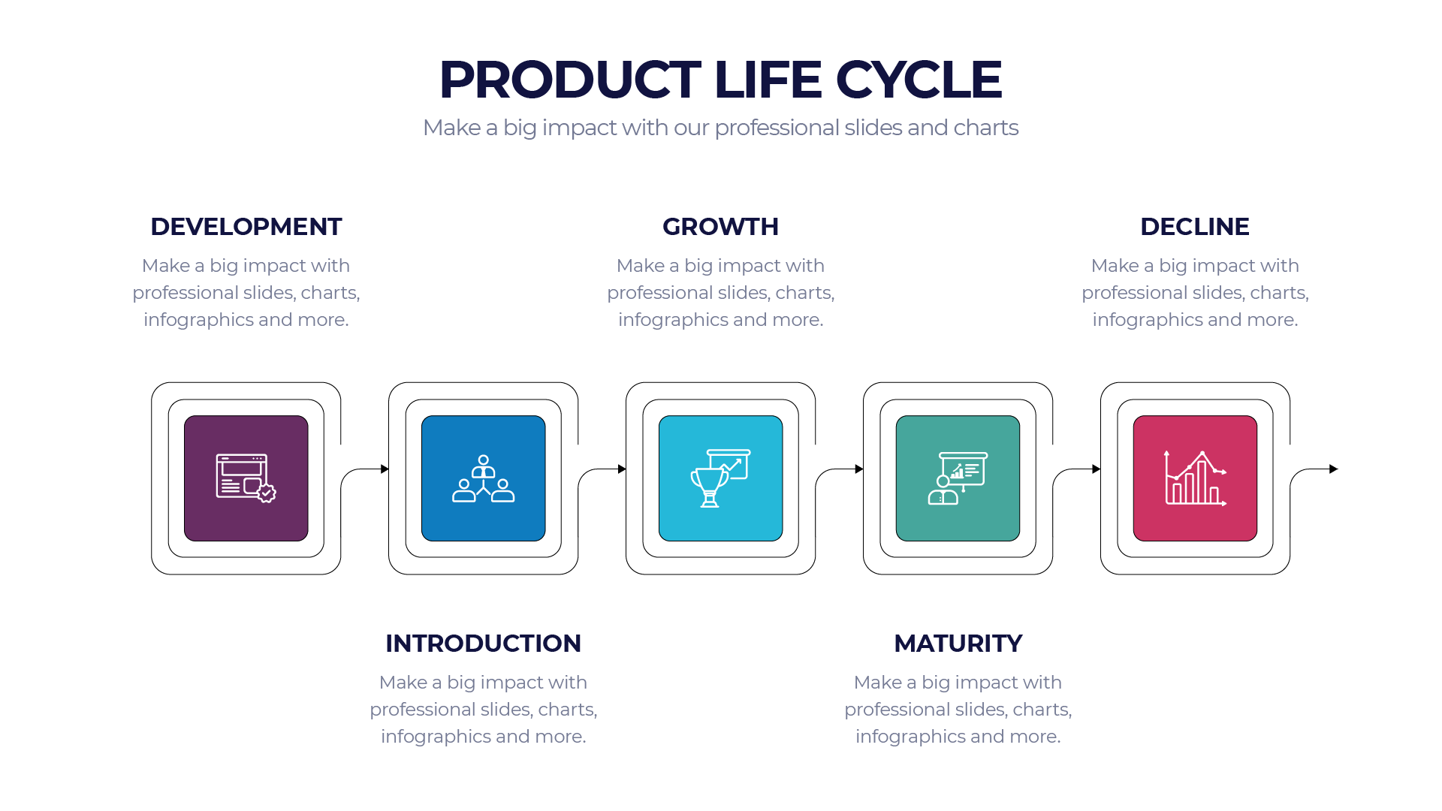
Updating Generation
Make More participant to Make big Generation
10.00%
3.50%
3.00%
2.50%
2.00%
First Generation
Second Generation
Third Generation
Fourth Generation
Fifth Generation
Six Generation
Eight Generation
Ten Generation
twelve Generation
Fourteen Generation
Sixteen Generation
1.50%
1.00%
0.80%
0.70%
2.00%
1.50%
0.90%
0.80%
0.70%
0.60%
0.50%
Seven Generation
Nine Generation
Eleven Generation
Thirteen Generation
Fifteen Generation
Netel Mart
Ludo Corner

Slide 12
Direct reference Facility
More Reference More Earning and More Facility
Direct reference
Facility
Diamond Partner Updating
Club Registration
Reference Code Use To Downloader
Rank Updating
10.00 %
10.00 %
30.00 %
8.00 C
Token
Gift token - 1 Piece
Netel Mart
Ludo Corner

Slide 13
Sub-Controller Club Power
When you will gain sub controller rank, then you can apply for club ownership
Sub Controller Club
Club owner can create tournament with own customization
Sub controller
Sub controller will get admin panel to maintain own club
Sub Controller Club
Monthly tournament create limit is 10 And distribution limit is 87.50%
Netel Mart
Ludo Corner

Slide 14
Controller Club Power
When you will gain controller rank, then you can apply for club ownership
Controller Club
Club owner can create tournament with own customization
Controller
Sub controller will get admin panel to maintain own club
Controller Club
Monthly tournament create limit is 15 And distribution limit is 87.50%
Netel Mart
Ludo Corner

Slide 15
Recovery fund
Dream rank - sub controller and controller
CONTROLLER
4%
Win 40% of minimum 30 game in a month to get recovery fund in your gift balance.
CONTROLLER
SUB CONTROLLER
SUB CONTROLLER
Win 40% of minimum 30 game in a month to get recovery fund in your gift balance.
6%
Netel Mart
Ludo Corner

Slide 16
Gift token power
You will get gift token when you direct referral every complete withdraw.
League Tournament
League Tournament
League Tournament
GIFT TOMEN
Netel Mart
Ludo Corner

Slide 17
Green token power
League tournament winner will get green token
TECHNOLOGY
EDUCATION
Technology product campaign.
25+ IT skill development course
GREEN TOKEN
GIFT
TRAVEL
Different kind of tournament with survey from user
Own Country tour and international tour
Netel Mart
Ludo Corner

Slide 18
SHARE HOLDER COMISSION SECTOR
Tournament Registration
Diamond Partner Updating
Rank Updating
1.00 %
1.50 C
3.50 %
1.00 %
3.50 %
20.00 %
Diamond Use
Betting
Club Registration
Netel Mart
Ludo Corner

Slide 19
Data apply to artificial intelligent
Data
90%
We will increase in this position within two years and we will try continue to increase intelligent power.
87%
We will increase in this position within 18 month
78%
74%
We will increase in this position within eight month
We will increase in this position within six month
You can apply only one time in a month
65%
One apply 10 data
Now intelligent power is that
Data apply
Data info
Netel Mart
Ludo Corner

Slide 20
Game assets
UPCOMING UPDATE
Share Holder Panel
Multi vendor E-commerce
Netel Mart
Ludo Corner

Slide 21
Thanks
Every One
2023
WILL BE
A GREAT YEAR
$10M
$100K
$50K
$10K
Netel Mart
Ludo Corner

Slide 22
WAIT ! WAIT !
Metaverse Platform
This is not the End !
This is just the Beginning.
Get Ready
100+ GAMES
Including Cricket, Football, Billiards, Royal Battle etc.
UPCOMING PROJECTS
Software Research Center
Netel Mart
Ludo Corner

